Slide 1
Burnout 2.0: 5 Elements of Wellbeing
This training video was supported by the Health Resources and Services
Administration (HRSA) of the U.S. Department of Health and Human
Services (HHS) as part of a financial assistance award totaling $750,000 with 100 percent funded by HRSA/HHS and $0 amount and 0 percent
funded by nongovernment source(s).
The contents are those of the author(s) and do not necessarily represent
the official views of, nor an endorsement, by HRSA/HHS,
or the U.S. Government.

Slide 2
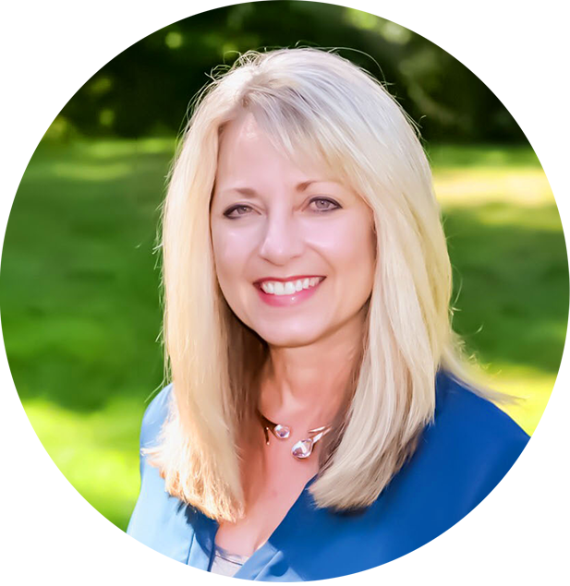
Burnout 2.0:
5 Elements of Wellbeing
Kim Perone, MA, CLC Wellbeing Coach, Consultant, and Mindfulness Facilitator
When clarity, compassion, and contentment are present an inspired life is possible.

Slide 3
Wellbeing is…
defined as
…the experience of health, happiness, and prosperity. It includes having good mental health, high life satisfaction, a
sense of meaning or purpose, and the ability to manage stress.
~ Dr. Tchiki Davis
Psychology Today contributor
Berkeley Wellbeing Institute
Notes:
Est 75% of dr visits are attributed to stress. Burnout is chronic unmanaged stress in the workplace. Our ability to tap into this paragraph, to understand and enable ourselves to have this, is key to wellbeing. Your workplace supports this and not only do you have access to individual sessions with me, you can specifically work on wellbeing with me, if you feel it is not where you would like it.

Slide 4
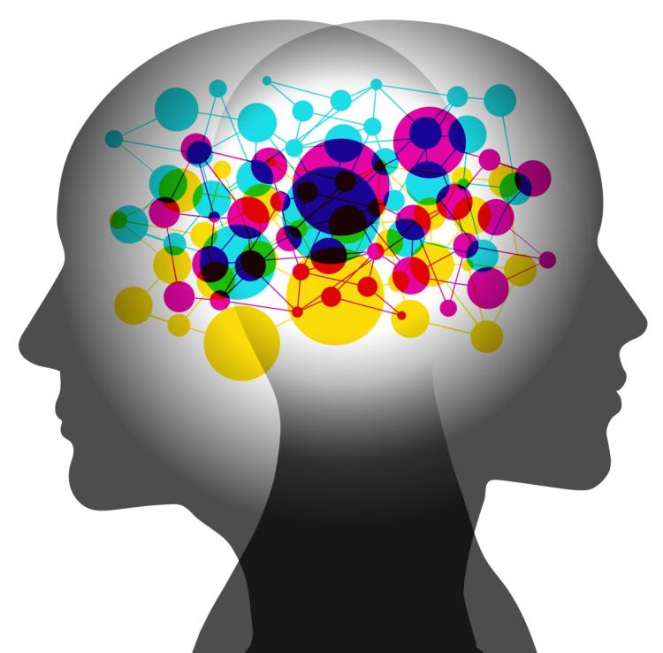
Wellbeing@Work
Wellbeing
Elements
Notes
Address Burnout
Growth Mindset
Patience & Trust
Positive Attitude
Mind/Body
Social
Workplace
Community
Financial

Slide 5
Wellbeing is something sought by just about everyone because it includes so many positive things — feeling happy, healthy, socially connected, and purposeful.
Unfortunately, wellbeing appears to be in decline, and increasing your wellbeing can be difficult without knowing what to do and how to do it.

Slide 6
Mind: Emotional Wellbeing
Hidden key to biggest gains.
Relaxation techniques
Stress management
Resilience (resistance & path forward)
Self-Love

Slide 7
Body:
Physical Wellbeing
You have energy to get things done.
Functioning body
Healthy living
Exercise
Food

Slide 8
Social Wellbeing
You have meaningful friendships in your life.
Communication
Connection
Support network
Showing up

Slide 9
Workplace Wellbeing
You like what you do every day.
Colleagues
Perspective
Meaning / Purpose
Professional enrichment

Slide 10
Community Wellbeing
You like where you live.
Participate
Contribute / Receive
Environment
Local / Global

Slide 11
Financial Wellbeing
You manage your money well.
Plan
Self-Control
Security
Foundation

Slide 12
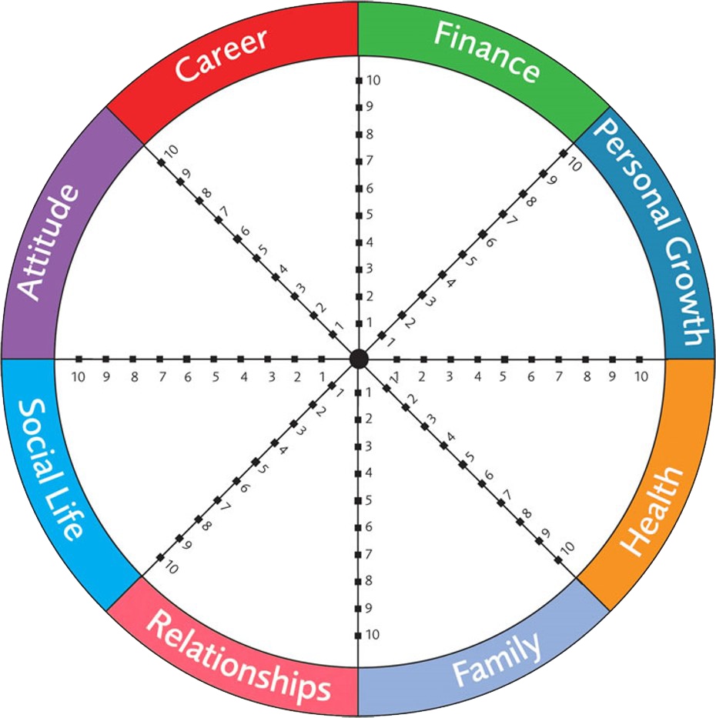
REFLECTION
The BIG picture
Take a step back and reflect…

Slide 13
Center4C Wellbeing Plan
Wellbeing Planning is….
A focus on the elements that make up wellbeing.
A plan to feel happy, purposeful, empowered, and healthy in body and mind.
Name: ___________________________________
Date Created: ____________
Cultivating clarity, compassion & contentment in our lives.
Mind - Emotional: __________________________________________________________________________________________________________________________
Body - Physical: __________________________________________________________________________________________________________________________
Social:
_________________________________________________________________________________________________________________________________
Workplace: __________________________________________________________________________________________________________________________
Community:
__________________________________________________________________________________________________________________________
Financial: __________________________________________________________________________________________________________________________
Intention: How do you want to feel?
________________________________________________________________________________________________________________________________________________________
Goals: What are short and long term goals?
Short__________________________________ ____________________________________________________________________________
Long______________________________ _________________________________ _________________________________
Kim Perone, MA, CLC, Wellbeing Coach, Consultant kperone@center4c.com (518) 301-3593 www.Center4c.com Find your center.

Slide 14
Your wellbeing matters
The elements work together
Life happens at work
Develop a plan
Show yourself compassion
…and don’t forget your
life is happening now!

Slide 15
Contact
Kim Perone, MA, CLC, CWMF
Wellbeing Coach, Consultant & Mindfulness Facilitator
kperone@center4c.com (518) 301-3593 center4c.com
Calendly.com/kimperone
www.facebook.com/
claritycompassioncontentment
"Opportunities to find deeper powers within ourselves come when life seems most challenging."
~ Joseph Campbell

