Slide 1
Resilience
This training video was supported by the Health Resources and Services Administration (HRSA) of the U.S. Department of Health and Human
Services (HHS) as part of a financial assistance award totaling $750,000 with 100 percent funded by HRSA/HHS and $0 amount and 0 percent
funded by nongovernment source(s).
The contents are those of the author(s) and do not necessarily represent
the official views of, nor an endorsement, by HRSA/HHS,
or the U.S. Government.

Slide 2
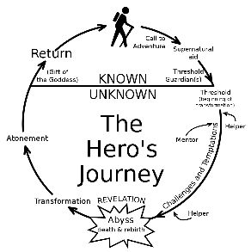
Resilience: Building the Skills & Realizing the Capability
Resilience is the ability to find a new path forward after a setback, loss or tragedy.
Benefits…
Key Aspects…
The Exercises…
Reduced Stress
Better Choices
Role Modeling
Improved ability to access hope, a vision for the future
Equanimity
Ability to access joy
Greater compassion
Perspective
Adaptation
Grief
Introspection
Emotions (EI)
Transcendence
Personal Growth
Community
Purpose
Connect with a former challenge. How did you handle it?
Staying with the Good (overcoming the brain’s default)
Connecting with common humanity.
Hero’s Journey
Finding the Path Forward
Hand on Heart practice meditation
Kim Perone, Success Coach & Mindfulness Trainer (518) 301-3593 Kperone@Center4C.com
www.Center4C.com, 850 Route 50, Burnt Hills, NY (not a mailing address, in the Haughey Insurance Building)

Slide 3
Perspective

Slide 4
Adaptation

Slide 5
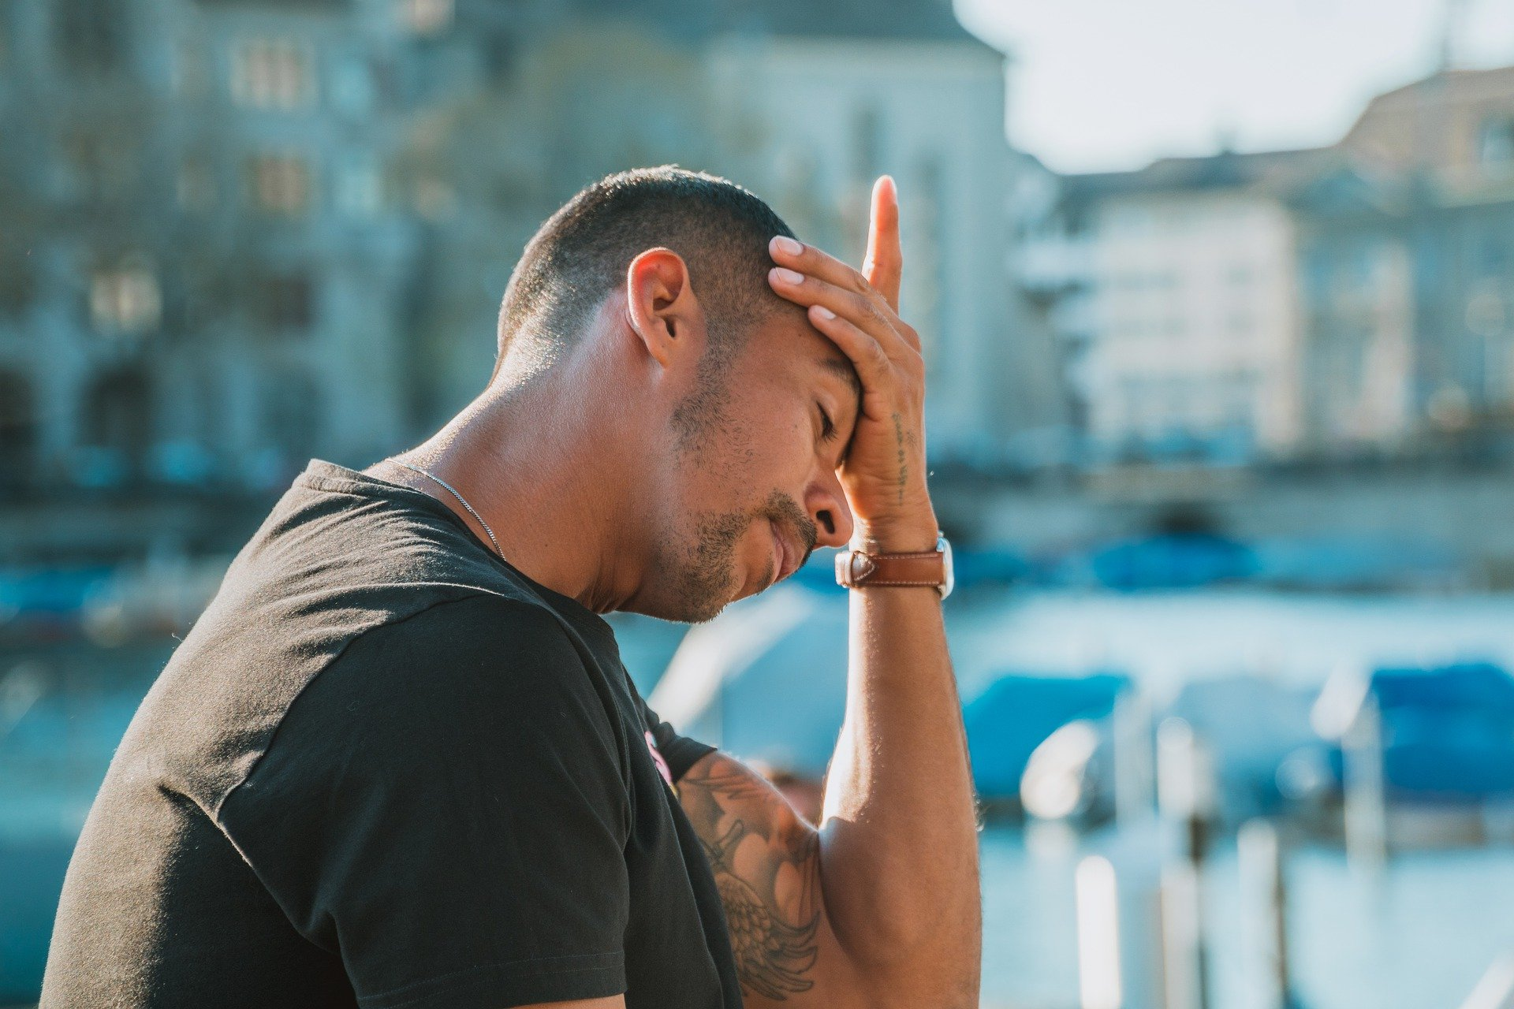
Grief

Slide 6
Introspection

Slide 7
Emotions

Slide 8
Transcendence

Slide 9
Personal Growth

Slide 10
Community

Slide 11
Purpose

Slide 12
Resilience: Building the Skills & Realizing the Capability
Resilience is the ability to find a new path forward after a setback, loss or tragedy.
Benefits…
Key Aspects…
The Exercises…
Reduced Stress
Better Choices
Role Modeling
Improved ability to access hope, a vision for the future
Equanimity
Ability to access joy
Greater compassion
Perspective
Adaptation
Grief
Introspection
Emotions (EI)
Transcendence
Personal Growth
Community
Purpose
Connect with a former challenge. How did you handle it?
Staying with the Good (overcoming the brain’s default)
Connecting with common humanity.
Finding the Path Forward
Hero’s Journey
Hand on Heart practice meditation
Kim Perone, Success Coach & Mindfulness Trainer (518) 301-3593 Kperone@Center4C.com
www.Center4C.com, 850 Route 50, Burnt Hills, NY (not a mailing address, in the Haughey Insurance Building)

Slide 14
Hand on Heart Practice
Place your hand on your heart. Breathe into it.
Remember one moment when you felt safe.
Let yourself experience the feelings of that moment.
Repeat this practice many times a day

